Slide 1


E.A.S
Endangered Animal Society QQW+***************************************************************

Slide 2
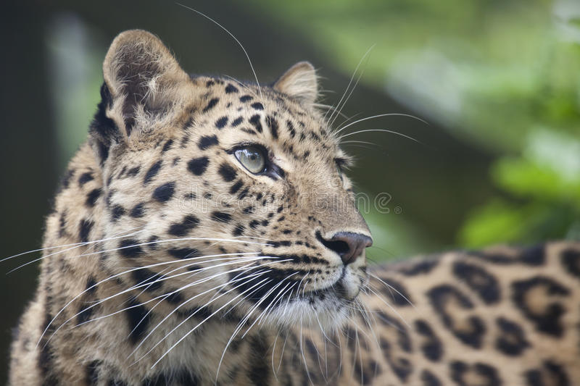
All About Our Business
Our group is E.A.S. – the Endangered Animal Society. We make Fact Frames based on endangered animals. A portion of the money we make goes to W.W.F to help protect life on
land and water. Through this business we
hope to raise awareness in our school about
sustainable development and the Global
Goals.

Slide 3
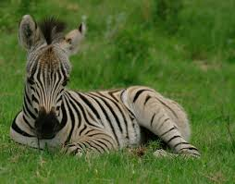

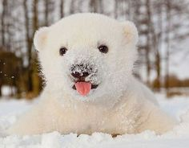
WWF
WWF is an organisation for endangered animals. WWF stands for World Wildlife Fund. Some of our money is going to WWF to raise money for endangered animals. The animals we based our product on are :Polar bears, Hawksbill turtle, Amur leopard and a Zebra.

Slide 4


Slide 5

Life on Land
Global development goal number 15 states that we must protect and restore life on land by 2030.
To help save the Amur Leopard and the Grevy Zebra
buy our frames today.

Slide 6

Life on Water
Global development goal number 14 states that we must conserve our oceans and seas.
To help save the 100 million year old Hawksbill Turtle
buy our frames today

Slide 7

Our JEP Story So Far..........
We got a visit from 3 Dragons, Ms. Alma Quinn, our Principal, Mr. O’ Connor, one of the school teachers and Mr. Paul Coyle, the owner of the Fruit and Veg shop. They gave us useful information on our products and then we took a vote, the E.A.S Snow globes won the vote.

Slide 8
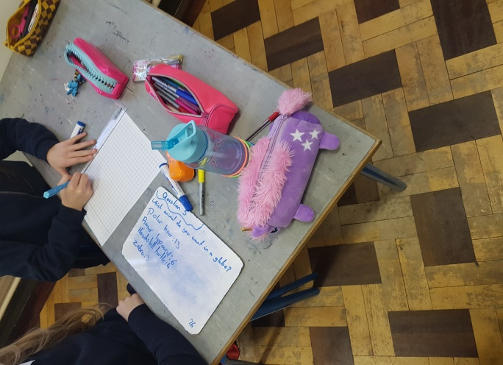
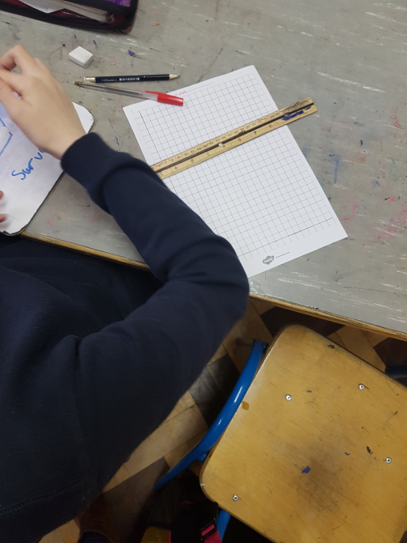
Carrying out our Market Research

Slide 9
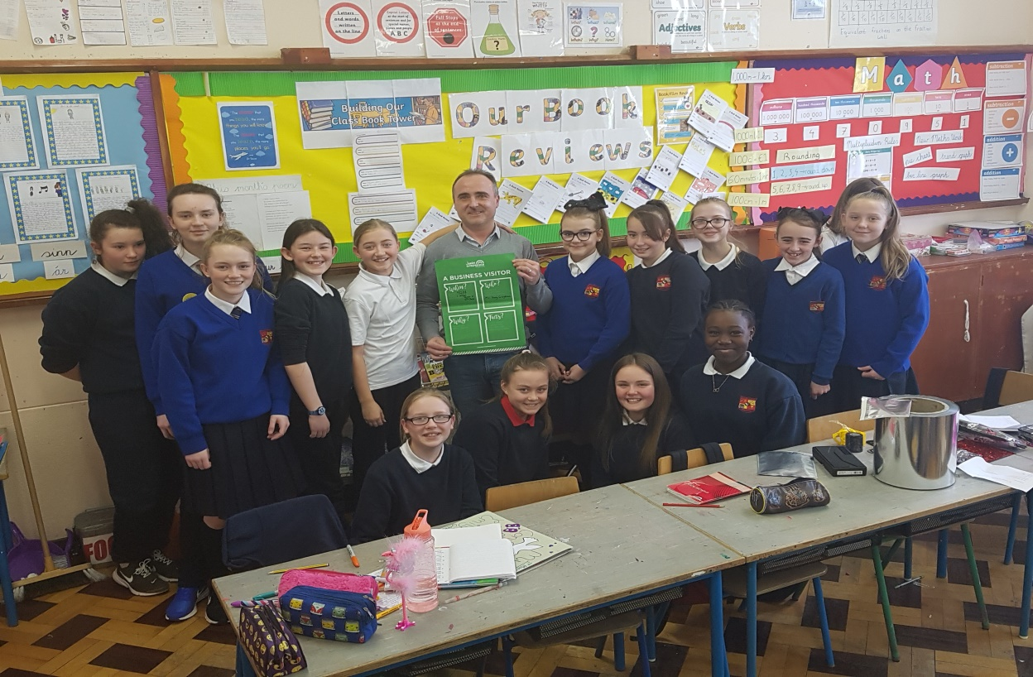
Our Business Visitor
We had a business visitor in our class. His name was Gary Creighton. He is Emma`s Dad. Gary owns a company called Dublin Flexible Packaging. He talked to us about all we needed to know about starting and running a business.

Slide 10
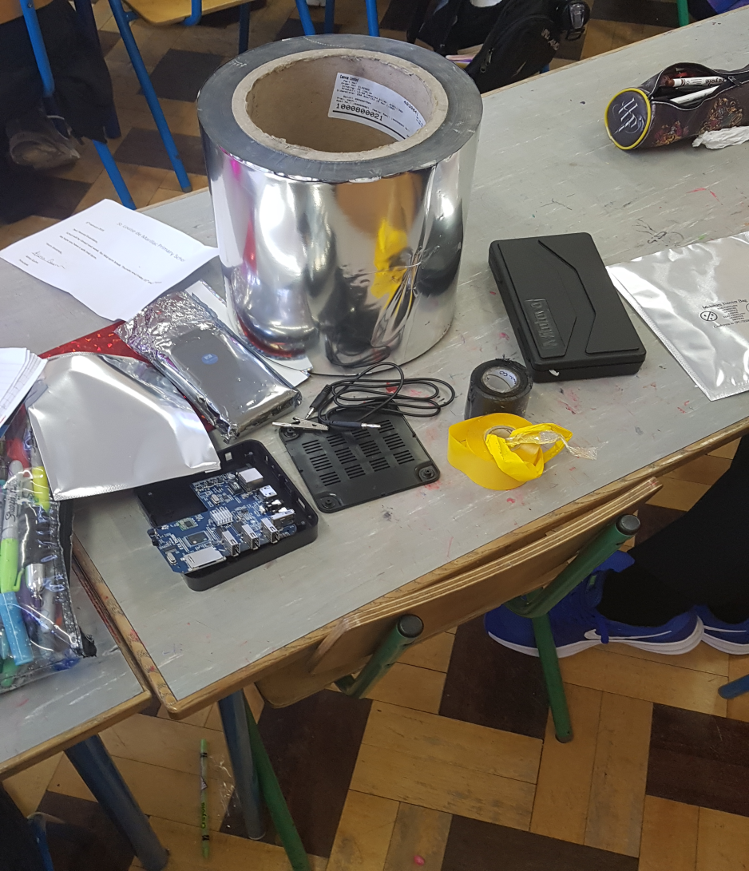
Mr. Creighton brought some raw
materials to show us how he produces
his foil bags. He told us if we can get these cheap – we can make a profit.

Slide 11
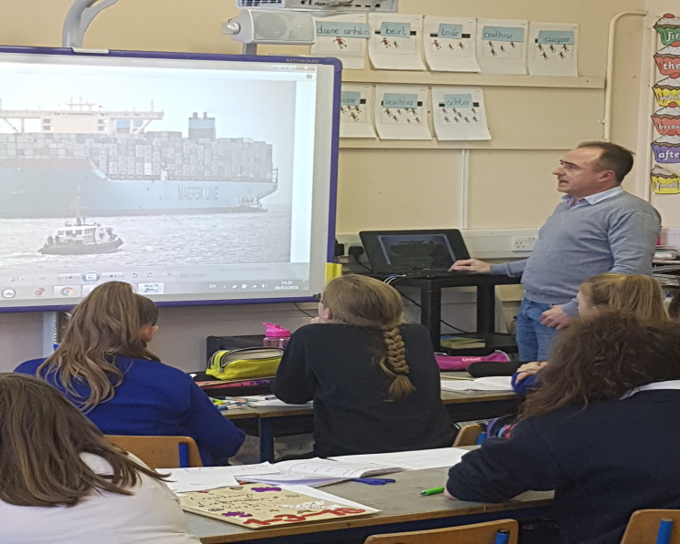
He also showed us videos of how his bags are transported to his customers in Europe. We saw a video of his machine making the foil bags also. He advised us to set up a production line for our product and to be careful with “quality control”

Slide 12
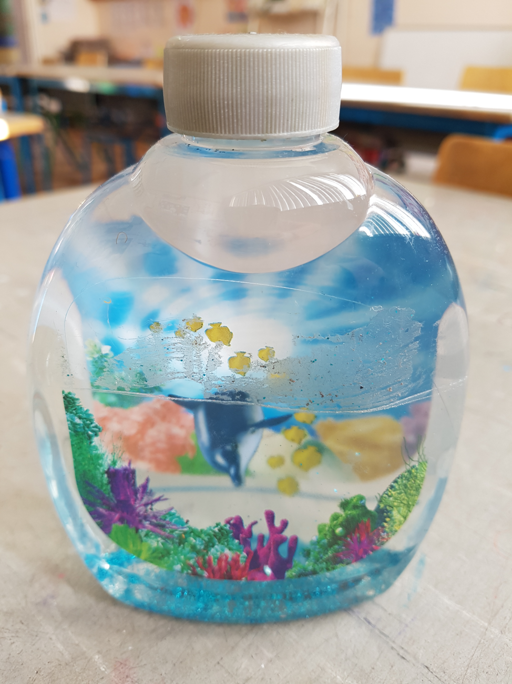
Rough Prototype of the E.A.S. Snowglobes

Slide 13
Changing Products
Well, even though our idea was great, when we did some more research we discovered the animal figurines were very expensive, so we changed our product to Fact Frames. Fact Frames are frames with endangered animals pictures on the front and on the back there will be facts about the animal. There will be a small and a large, the small is €1.50 and the large is €1.75. This way we still get to help the animals in danger.

Slide 14
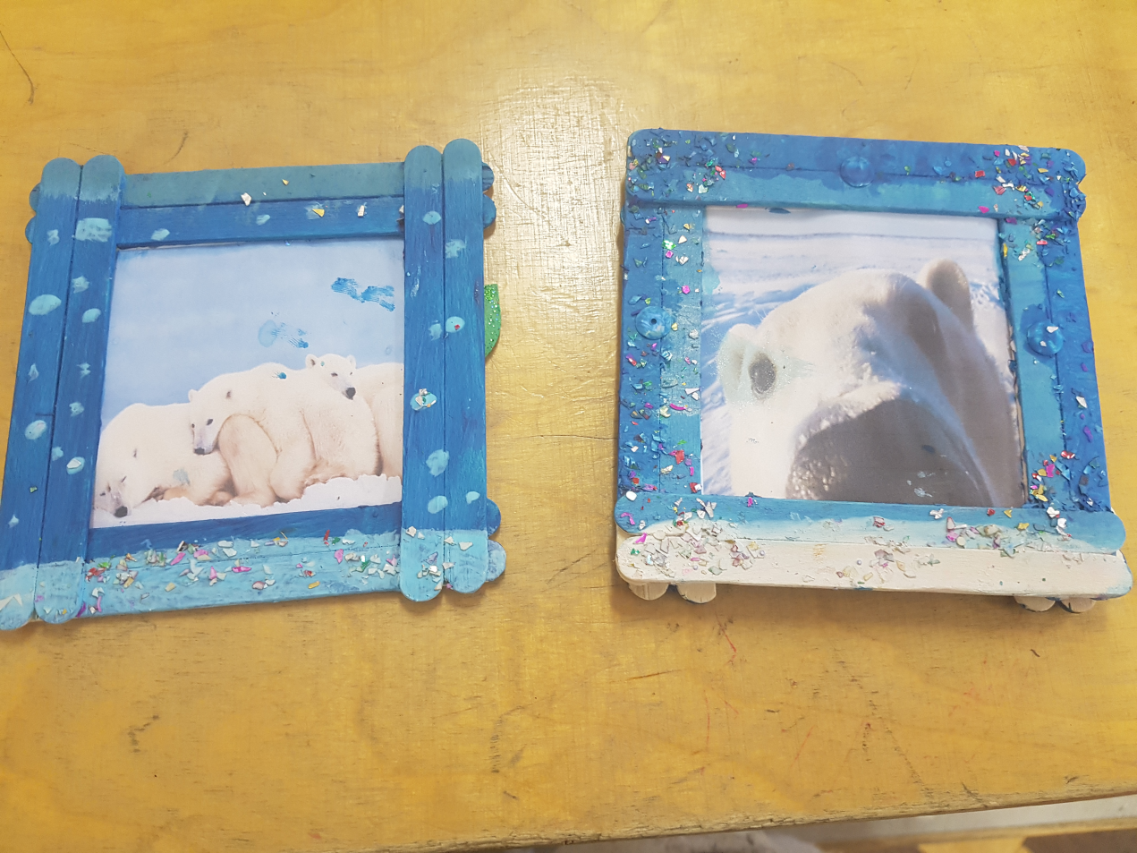
The Frames
This is a rough model the E.A.S fact frames
This rough
model is made
out of lollipop
sticks, glue and
a picture of a
polar bear.

Slide 15
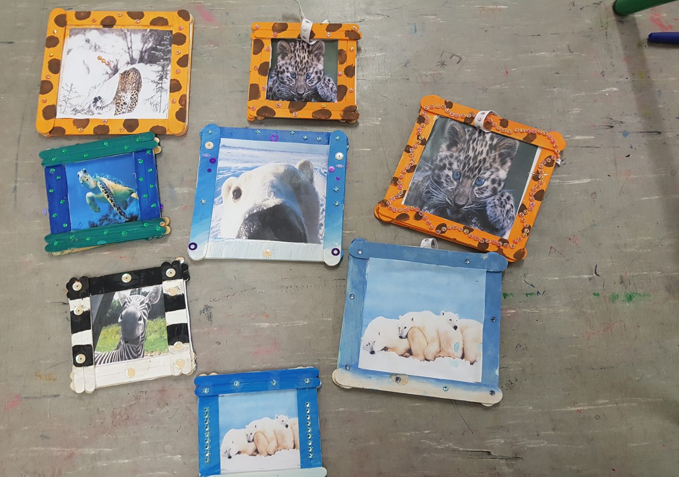
The Hand-crafted Frames
Here are some sample products. This is the
front of the frames :
.

Slide 16
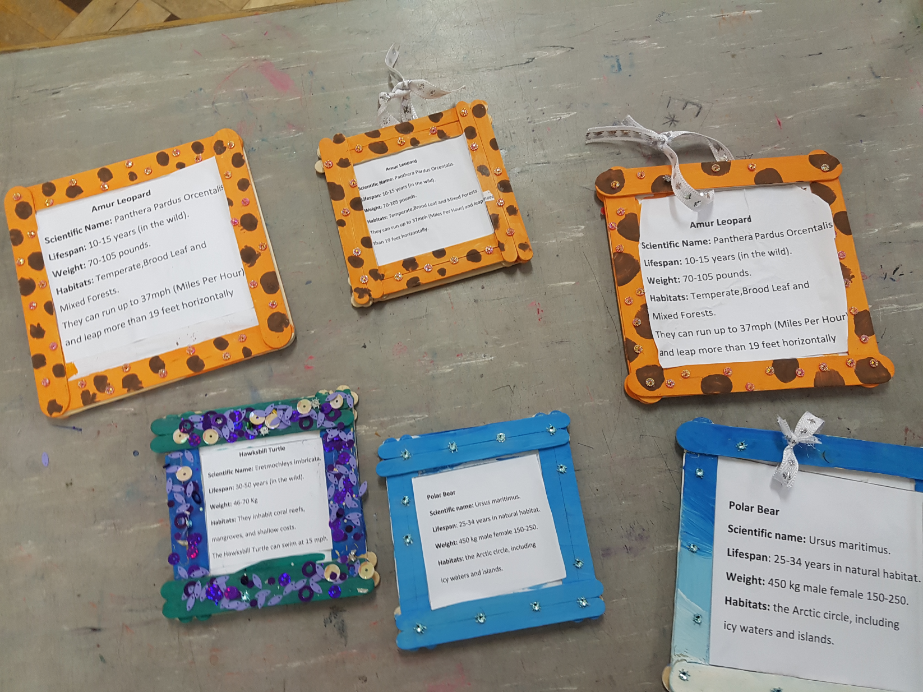
And this is the back with the facts

Slide 17
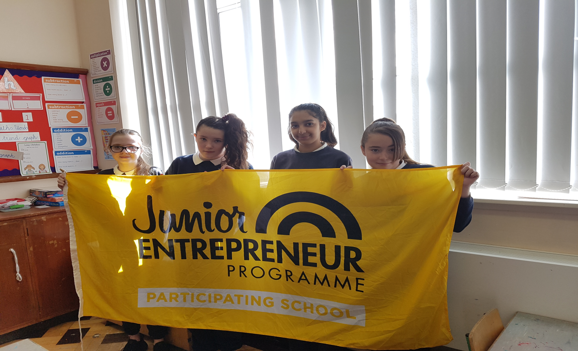
Meet The Teams !
Meet the finance team - Emma Creighton , Kaci Stokes, Kila Maher and Fiona Plesca
We took investments from the class and decided how much to donate to WWF.

Slide 18
Meet The Teams!
Meet the Story telling team - Emily-Kate Greene, Erin Finnerty Hackett, Nicole Coombes and Shannon Farrell
We made this powerpoint to tell everyone about our business E.A.S.

Slide 19
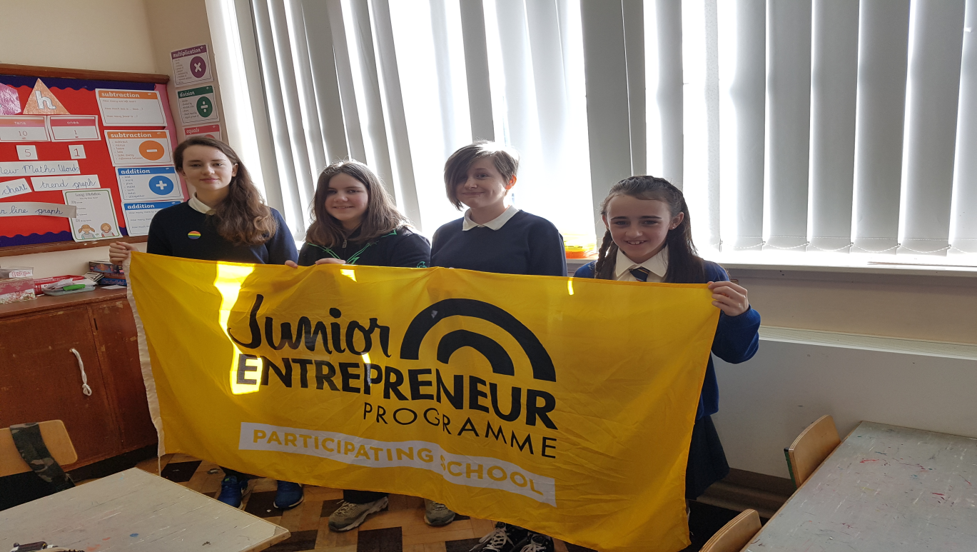
Meet The Teams!
Meet The Design and Production team Amber Eastwood , Jamie Matthews , Molly O’ Gorman and Bobbi Smyth
This team designed our frames – they chose animals, colours and what facts to include.

Slide 20
Meet The Teams!
Meet The Sales Team - Alannah Lawlor, Jainaba Bance , Karly O’ Neill and Louise O’ Brien
This team have made lots of decisions about Showcase day on April 10th in the school hall.
They are going to make sure lots of animal facts and reports will be on the walls and posters about the Global Goals.

Slide 21
Meet The Teams!
Meet The Marketing Team : Brooke O Brien, Courtney Collins, Zoe Howe and Caitlin Delany
This team has an important job. They advertise our product around the school and raise awareness of Global Goals 14 and 15.

Slide 22
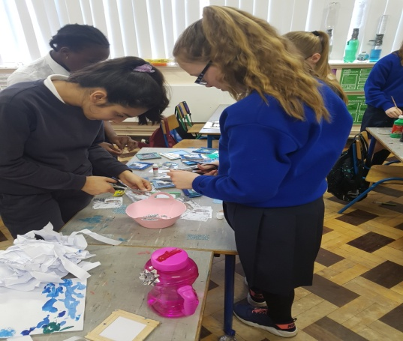
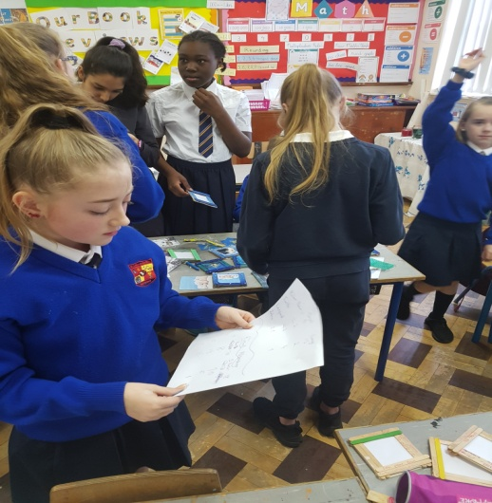
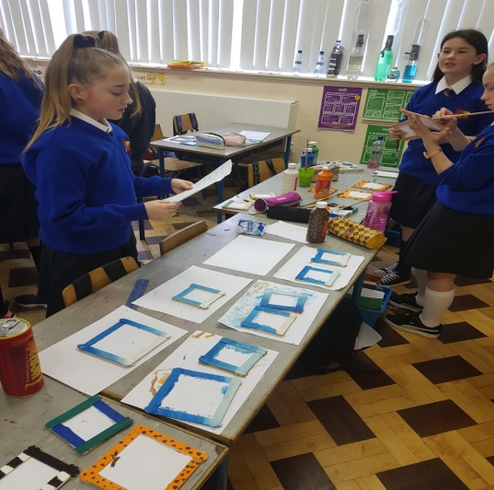
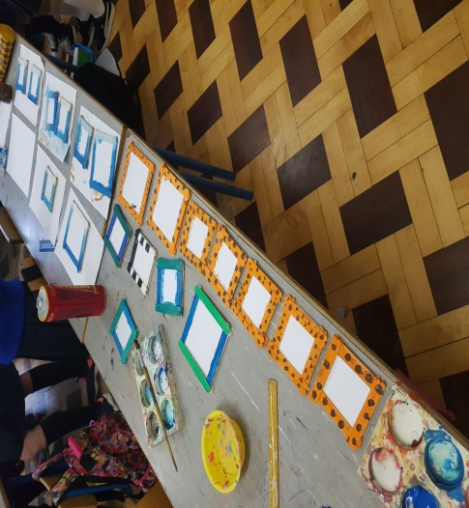
These are some pictures of us working on the Fact Frames

Slide 23
Thank you for coming to our Showcase Day today, Tuesday April 10th in the
School Hall and for supporting our Business – E.A.S.
BY
ROOM 21 6TH CLASS

